Slide 1


Slide 2
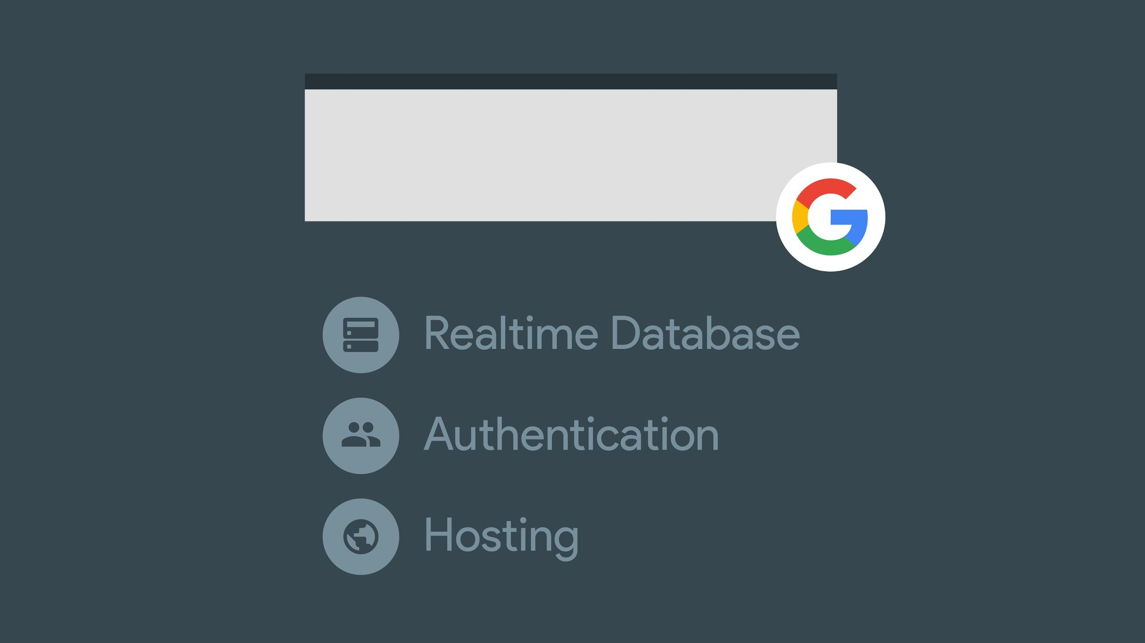


Slide 3

450,000 Developers

Slide 4
Creating a successful app is still too hard

Slide 5


Developers are time and resource constrained
Proprietary + Confidential

Slide 6
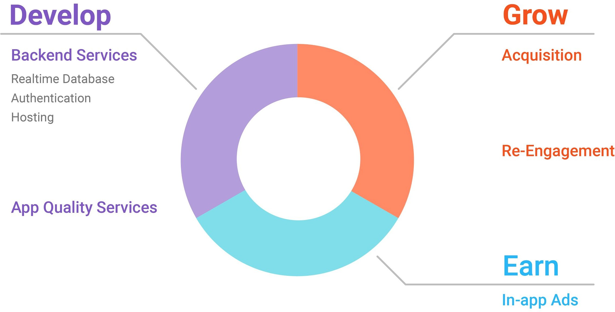

Slide 7

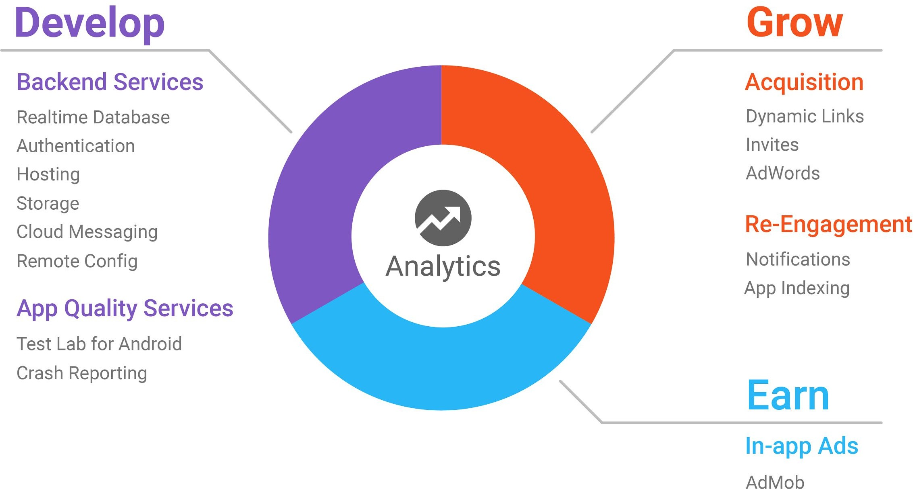

Slide 8
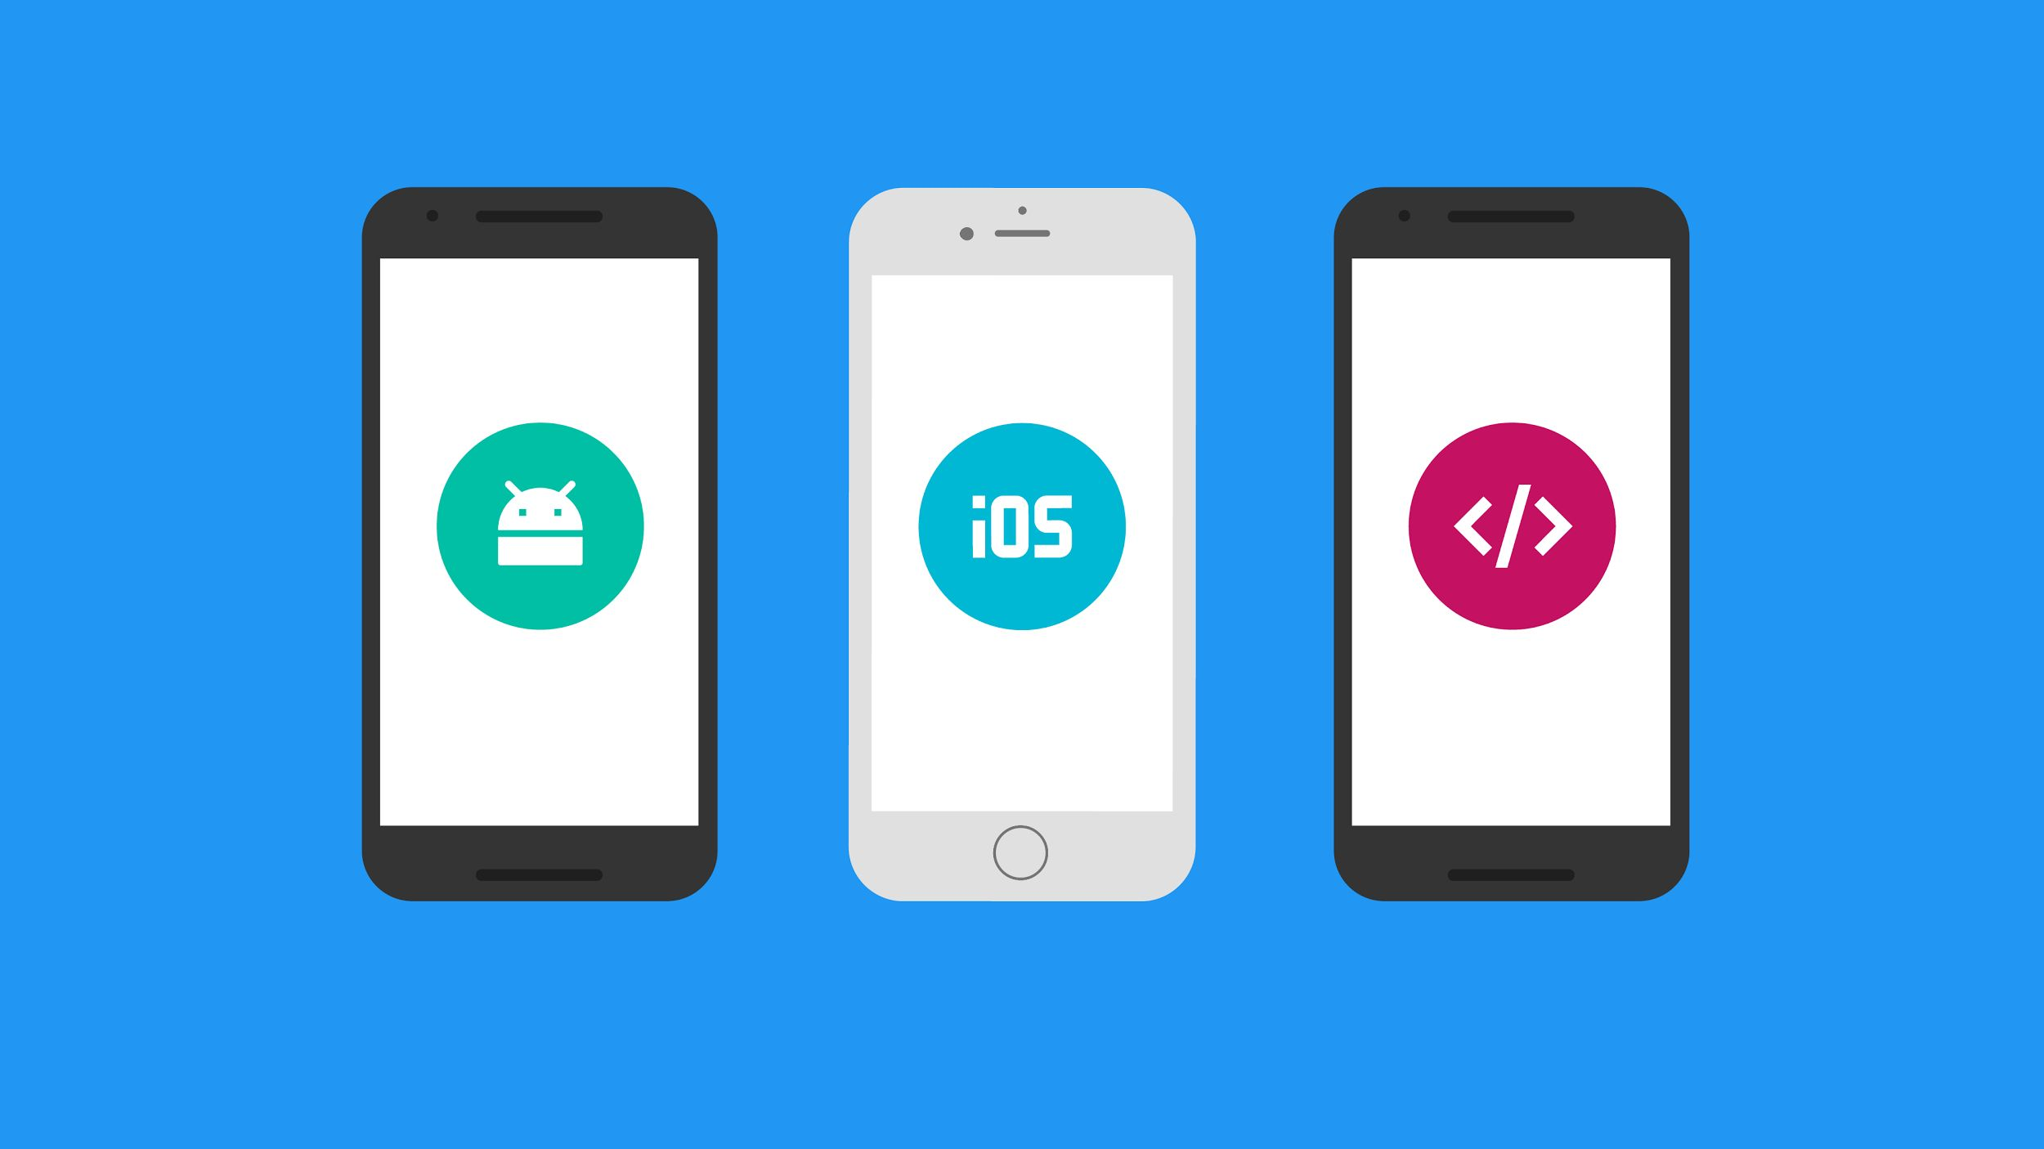

Cross-platform

Slide 9

Integrated

Slide 10
Developing your app

Slide 11
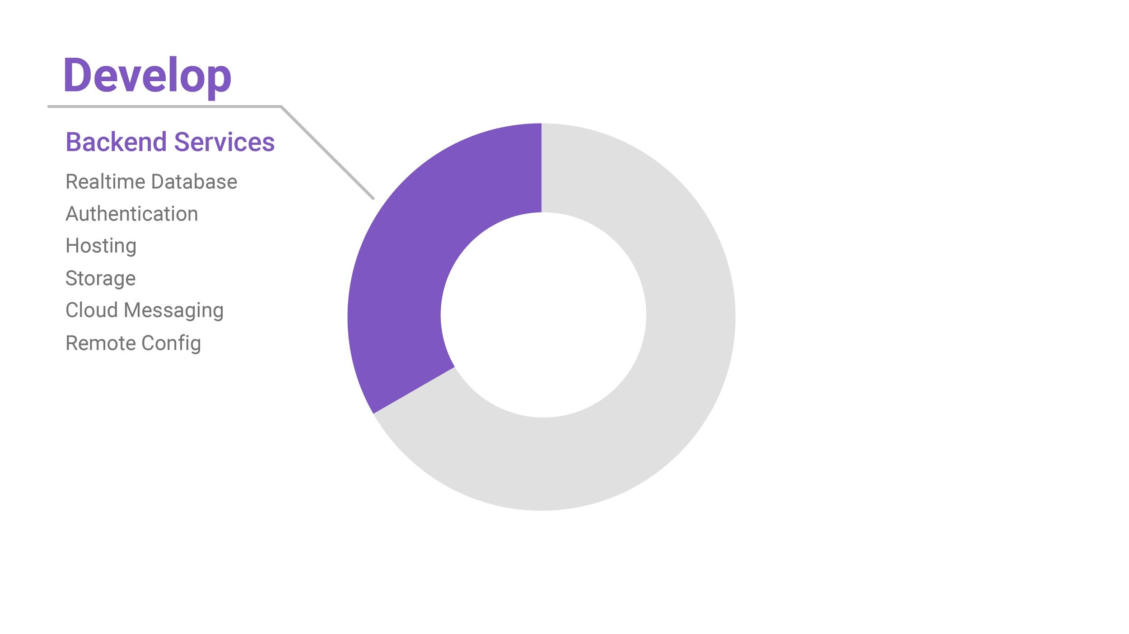
Backend Services

Slide 12
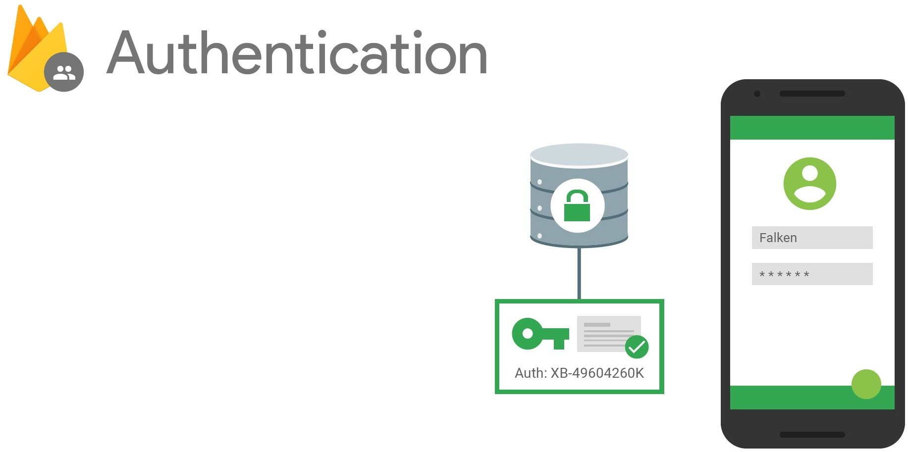
Authentication & account management
Supports:
Email & password
Social providers
Existing auth systems
[New!] Out-of-the box UI

Slide 13
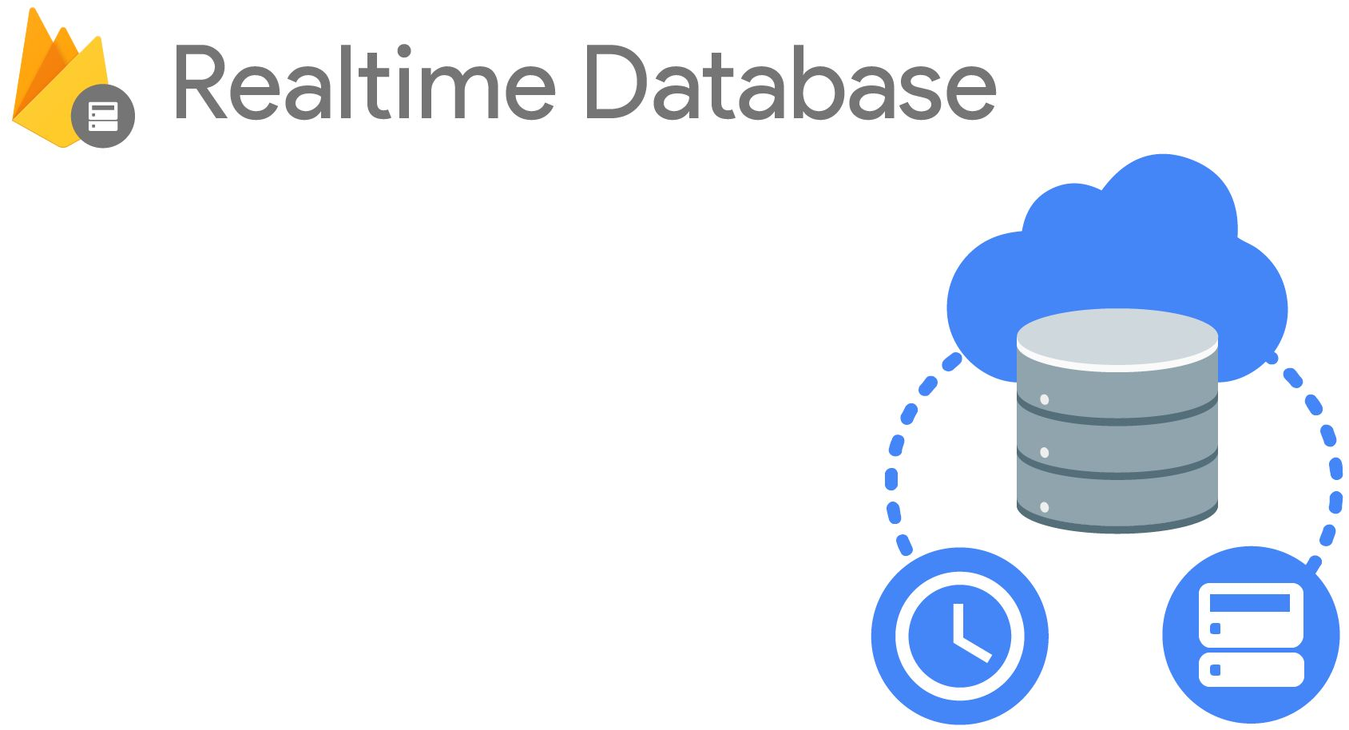
Cloud-hosted NoSQL database
Synchronization & conflict resolution
Access directly from your app

Slide 14

SectionX
SectionY SectionZ
Serve static assets (images too)
SSL by default
New: free custom domains

Slide 15
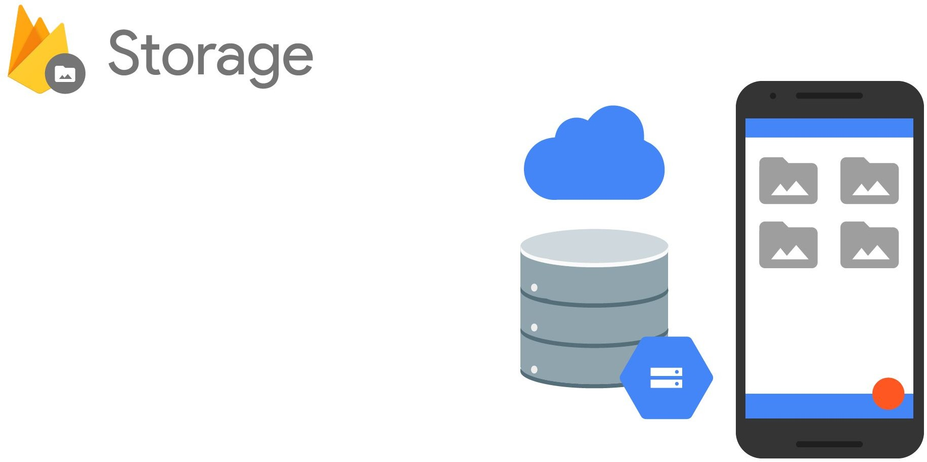
Easy file storage
Handles poor connectivity
Backed by & accessible from Google Cloud Storage

Slide 16
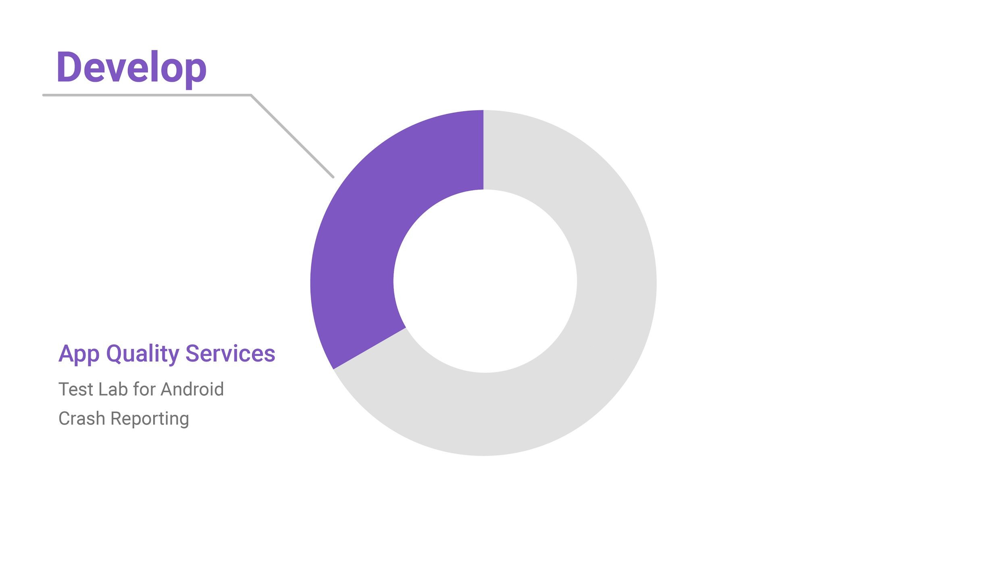
App Quality Services

Slide 17
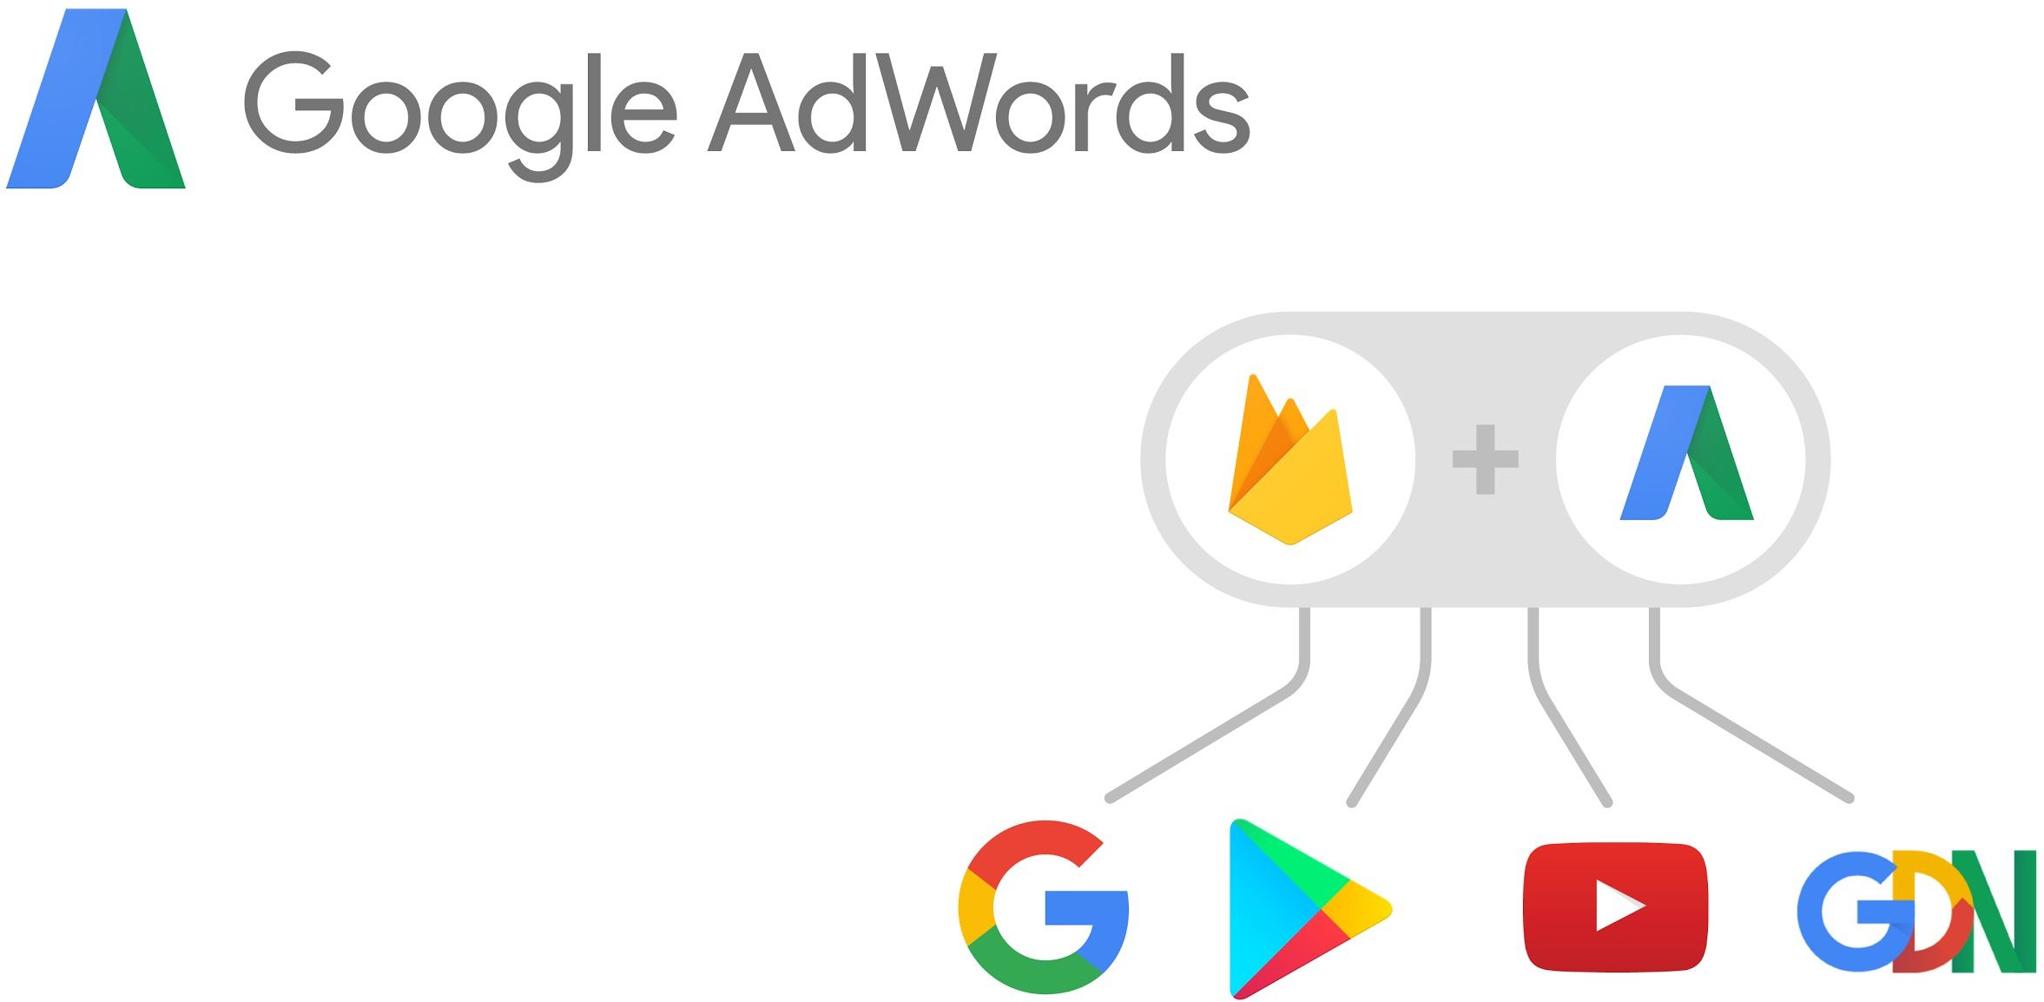
Universal App Campaigns
2B downloads to date
Android & iOS
Audience re-targeting
Conversion tracking and optimization

Slide 18
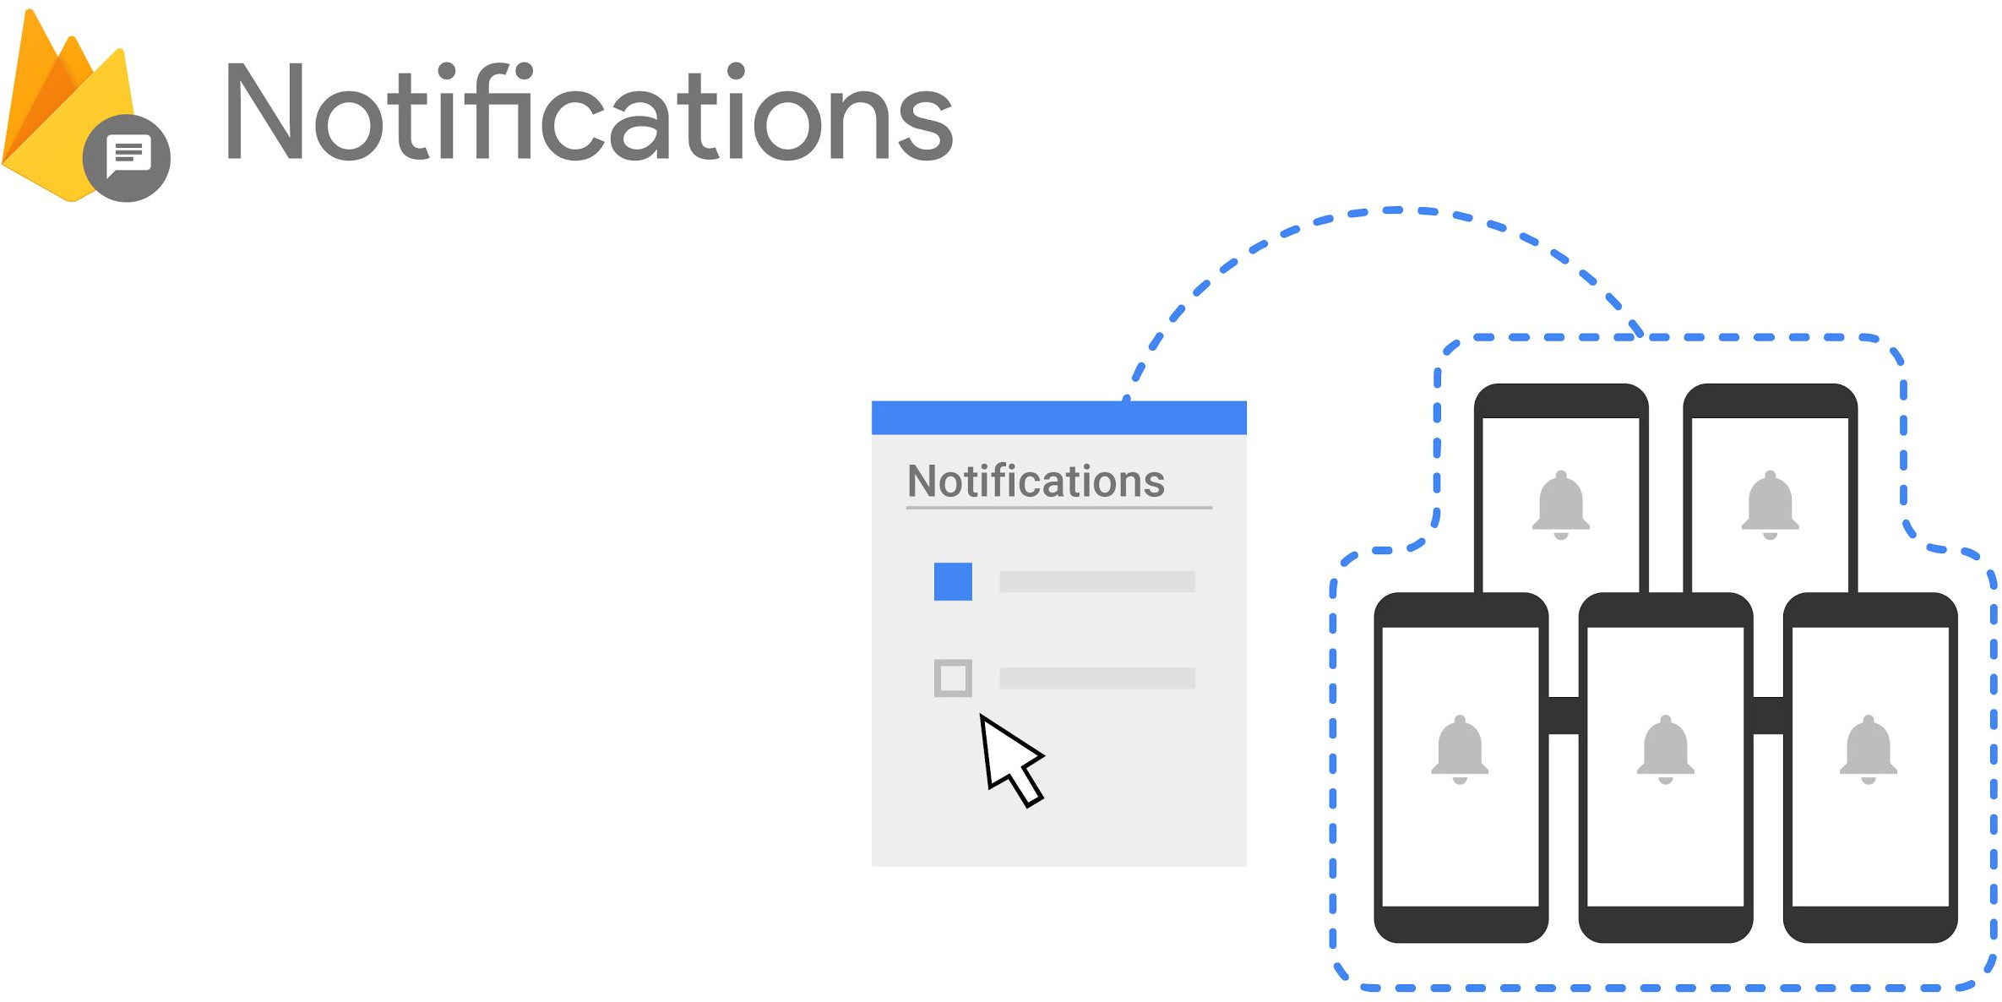

Simple UI, with no coding
Built on Cloud Messaging
Audience targeting
Conversion funnel insights

Slide 19
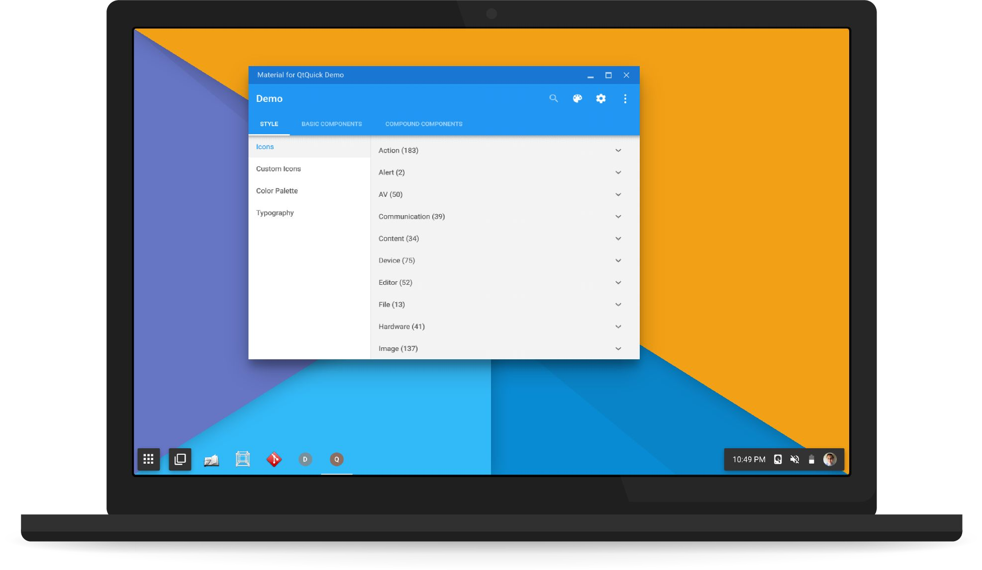
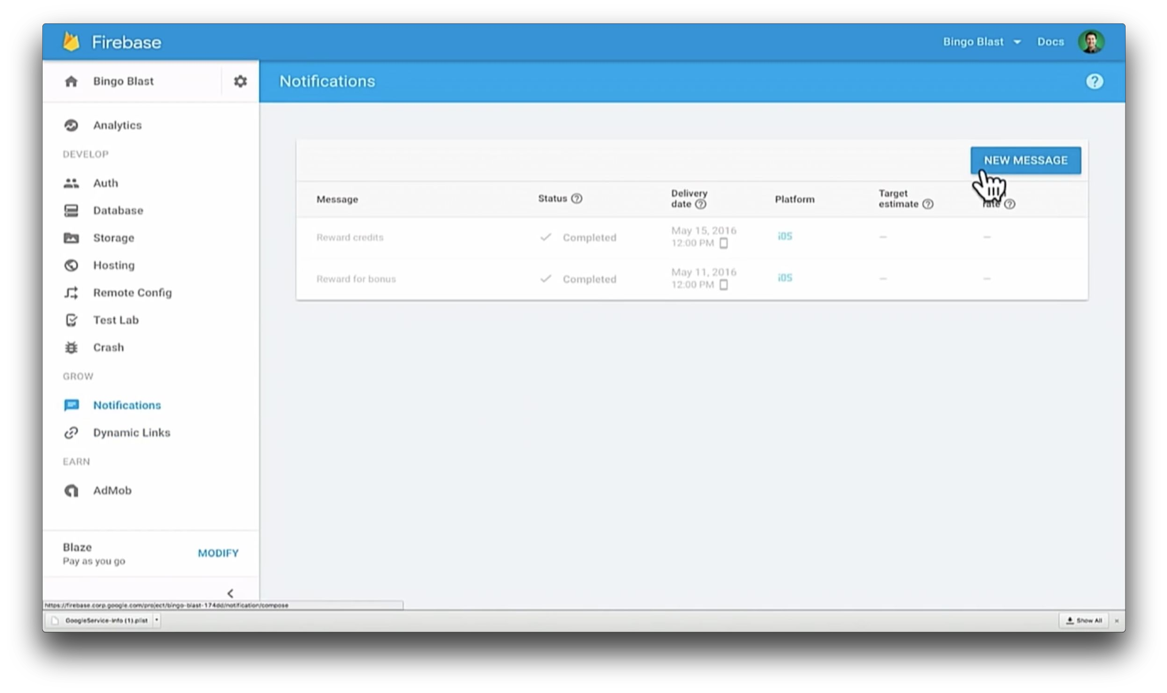

Slide 20
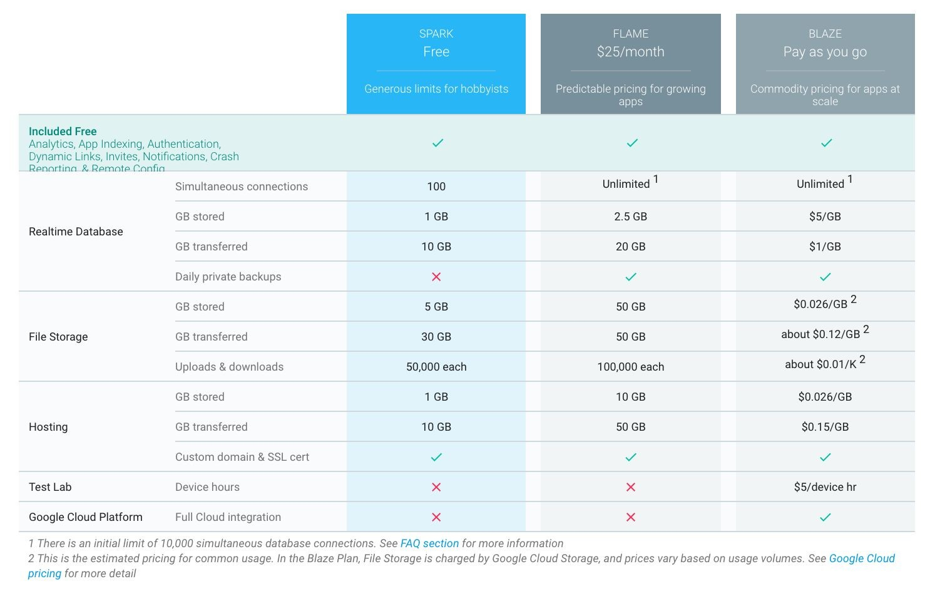

Slide 21

More Firebase
Sample app: FriendlyPix github.com/firebase/friendlypix
Codelab: FriendlyChat github.com/firebase/friendlychat
Get help and join the conversation firebase.google.com/support
firebase.google.com youtube.com/firebase twitter.com/firebase

